Slide 1
Matlab程式設計_5_18
助教:金郁善

Slide 2
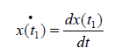
Differential equation (ode functions)
[t.x] = ode23(xprime, tstart, tfinal, xo, tol, trace)
[t.x] = ode45(xprime, tstart, tfinal, xo, tol, trace)
Xprime=

Slide 3
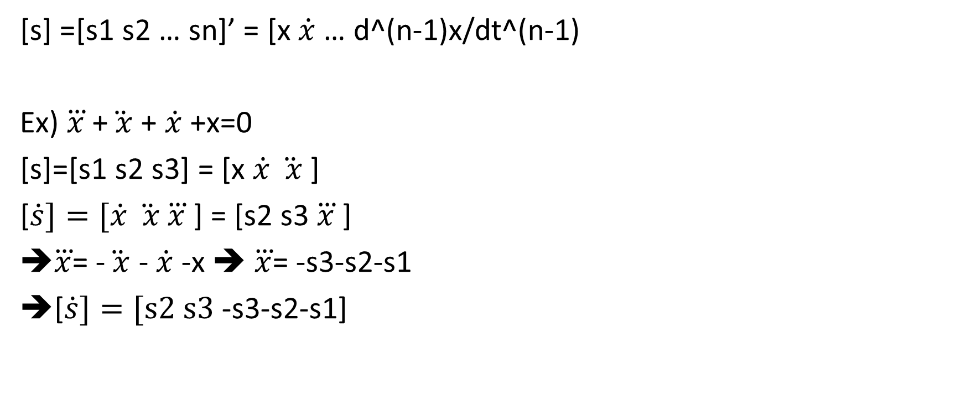

dot x =$\dot{x}$
[s] =[s1 s2 … sn]’ = [x $\dot{x}$… d^(n-1)x/dt^(n-1)
Ex) $\overset{⃛}{x}$ +$\ddot{ x}$ + $\dot{x}$+x=0
[s]=[s1 s2 s3] = [x $\dot{x} \ddot{ x}$ ]
[$\dot{s}]=[\dot{x} \ddot{ x}$ $\overset{⃛}{x}$ ] = [s2 s3 $\overset{⃛}{x}$ ]
$\overset{⃛}{x}$= -$\ddot{ x}$ - $\dot{x}$-x ➔ $\overset{⃛}{x}$= -s3-s2-s1
[$\dot{s}]=[s2 s3$-s3-s2-s1]
F=@(x,y) [y(2); y(3); -y(3)-y(2)-y(1)]
[x,Y] = ode45(F, [1 10] , [1 2 5] );

Slide 4
HOMEWORK

Slide 5
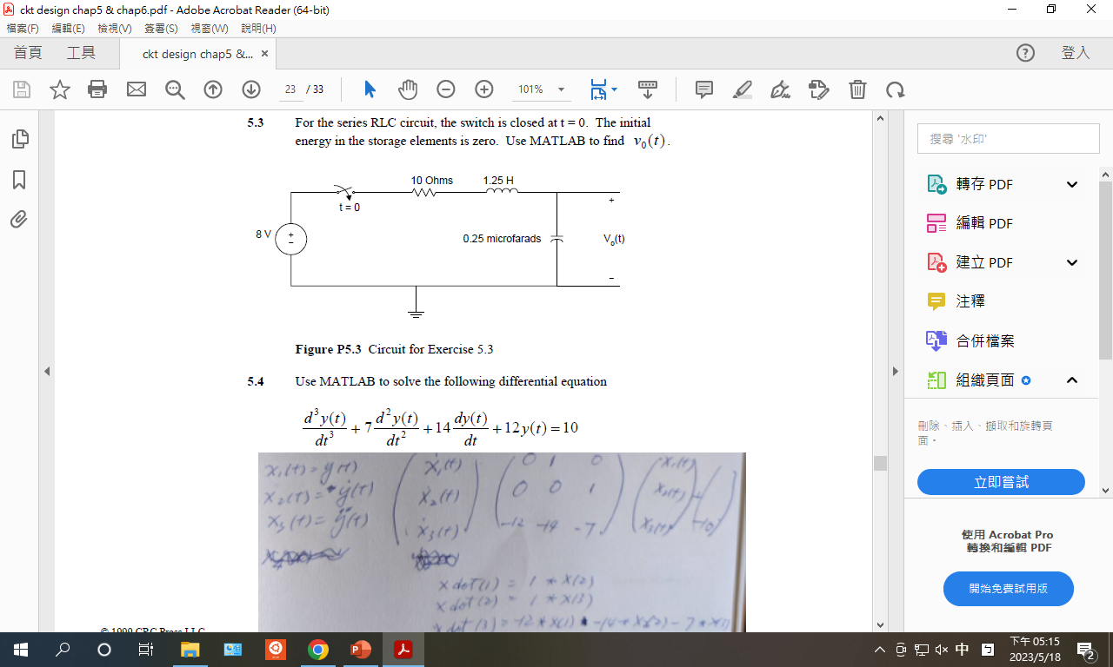

Slide 7
